Slide 1

Skagit County
Public Works Department
Ferry Division
2026 Draft Ferry Fare Revenue Target Report
August 18, 2026, 8:30 a.m.
Rachel Rowe
Ferry Division Manager

Slide 2
2026 Draft Ferry Fare Revenue Target Report
2027 Fare Setting Methodology
Resolution R20230152 (signed by BCC July 27, 2023)
Evaluation period - 2024 through 2028
5-year average methodology
65% fare recovery requirement by December 31, 2028
Capital expenditures not included

Slide 3
O&M Expenditures Vs. Capital Expenditures
GCC 1147 – Interagency Agreement Between WSDOT Local Programs & Skagit County
Definition of O&M Expenditures:
Routine cost of operating and maintaining the ferry, including salaries, benefits, fuel, supplies, utilities, repairs, inspection, advertising, taxes, small tools, land leases, rentals, postage, printing, etc.
Routine anticipated replacement of piling, wing-wall facing, repairing docks, etc. which does not extend the useful life, nor increase the efficiency or capacity of an asset
Routine dry-docking and associated repairs to maintain the vessel’s certification
Routine engine repair or rebuilding
Other work not defined as capital and agreed to in writing by WSDOT
Excludes:
Depreciation
Interest
Other work or repairs that are considered capital in nature

Slide 4
O&M Expenditures Vs. Capital Expenditures
WAC 136-400-030
Definition of ferry capital improvement projects:
Purchase of a new vessel which replaces an existing vessel
Major vessel refurbishment (e.g., engines, structural steel, controls) that substantially extends the life of the vessel
Facility refurbishment/replacement (e.g., complete replacement, major rebuilding or redecking of a dock) that substantially extends the life of the facility
Installation of items that substantially improve ferry facilities or operations and/or
Construction of infrastructure that provides new or additional access or increases the capacity of terminal facilities

Slide 5
2027 Revenue Target – Page 2
Table 1 - Revenue Target Calculation Table
 | Actual |  | Adjusted Budget | Projected |  | Five-Year Average
Year | 2024 | 2025 | 2026 | 2027 | 2028
O&M Expenditures | $ 2,892,256 | $ 4,694,137 | $ 5,005,064 | $ 5,168,230 | $ 5,295,368 | $ 4,611,011
MVFT | $ 62,400 | $ 93,103 | $ 114,406 | $ 114,406 | $ 114,406 | $ 99,744
Deficit Reimbursement | $ 269,830 | $ 291,086 | $ 281,931 | $ 281,931 | $ 281,931 | $ 281,342
Youth Ride Free Reimbursement | $ 11,641 | $ 14,774 | $ 29,302 | $ 30,000 | $ 30,000 | $ 23,143
Adjusted O&M | $ 2,548,385 | $ 4,295,174 | $ 4,579,425 | $ 4,741,892 | $ 4,869,031 | $ 4,206,781
2027 Fare Recovery % |  |  |  |  |  | 60%
2027 Ferry Fare Revenue Target |  |  |  |  |  | $ 2,524,069

Slide 6
2026 Annualized Expenditures – Page 2
Figure 1 – Annualized Maintenance Expenditures
Annualized Drydock & Non-drydock maintenance/repairs | 2027/2028 Est. | 2026 Adjusted
2027/2028 Planned Drydock (Total for 2 years) ⁽¹⁾ | $ 1,035,153
Annualized Drydock |  | $ 517,576
Average Non-Drydock Maintenance/Repair ⁽²⁾ |  | $ 388,628
Annualized Base Year Maintenance |  | $ 906,204
⁽¹⁾ Based on actual O&M cost for 2025 drydock ($900,634) and YTD expenditures for pier side maintenance ($134,519)
⁽²⁾ Annualized Non-Drydock Maintenance/Repair | 2024 Actual | 2025 Actual | Average
Maintenance expenditures other than drydock | $ 244,042 | $ 533,215 | $ 388,628

Slide 7
2026 Base Year Expenditures – Page 3
Figure 2 – Base Year Expenditures
 | Actual |  | Current Year Adopted Budget as of 6/30 | Projected
 | 2024 | 2025 | 2026 | 2027 | 2028
Obj. 510 - Salaries & Wages | $ 1,171,006 | $ 1,338,537 | $ 1,564,402
Obj. 520 - Personnel Benefits | $ 384,785 | $ 482,100 | $ 488,370
Obj. 530 - Supplies & Consumables | $ 255,441 | $ 282,491 | $ 482,223
Obj. 540 - Services & Pass-throughs | $ 1,081,024 | $ 2,591,009 | $ 2,685,865
Sub-Total | $ 2,892,256 | $ 4,694,137 | $ 5,220,860
Haul-Out & Maintenance Expenditures |  |  | ($1,122,000)
Without haul out & maintenance expenditures |  |  | $ 4,098,860 | $ 4,232,483 | $ 4,336,602
Annualized repair, maintenance & haul out |  |  | $ 906,204 | $ 935,747 | $ 958,766
Plus annualized haul out & maintenance |  |  | $ 5,005,064 | $ 5,168,230 | $ 5,295,368
Total | $ 2,892,256 | $ 4,694,137 | $ 5,005,064 | $ 5,168,230 | $ 5,295,368

Slide 8
2025 Revenue Target – Page 4
TABLE 2 - 2025 REVENUE TARGET
Ferry Fare Revenue Target | $ 1,818,971
Fare Box Revenue | $ 1,455,098
Surplus/(Shortfall) from Revenue Target | $ (363,873)

Slide 9
2025 Ferry Funding Breakdown – Pages 4 & 5
TABLE 3 - ROAD FUND SUBSIDY 2025
O&M Expenditures | $ 4,694,137
Deficit Reimbursement | $ (291,086)
Motor Vehicle Fuel Tax | $ (93,103)
Youth Ride Free | $ (14,774)
Adjusted O&M Expenditures | $ 4,295,174
Fare Box Revenue | $ (1,455,098)
Subtotal | $ 2,840,076
FHWA FBP Funding | $ (604,964)
Road Fund Contribution | $ 2,235,112

Slide 10
Trends - Historical & Current Farebox Recovery Methodology Applied – Page 6
TABLE 6 - Variation between O&M, adjusted O&M, and revenue target
 | 2021 | 2022 | 2023 | 2024 | 2025 | 2026 Budgeted | 2027 Proj. | 2028 Proj. | 2029 Proj.
Total O&M Exp. | $3,144,332 | $2,904,594 | $3,672,134 | $2,892,256 | $4,694,137 | $5,220,860 | $5,168,230 | $5,295,368 | $5,454,229
Adjusted O&M Exp. | $2,826,710 | $2,319,930 | $3,309,507 | $2,548,385 | $4,295,174 | $4,579,425 | $4,206,781 | $4,332,985 | $4,462,974
Revenue Target | $1,386,935 | $1,463,031 | $1,307,220 | $1,307,220 | $1,818,971 | $2,319,876 | $2,524,069 | $2,816,440 | $2,900,933

Slide 11
Trends – Fare Box Revenue Vs. Road Fund Contribution – Page 7
Table 7: Five-Year Trend of Fare Box Revenue Vs. Road Fund Contribution
 | 2021 | 2022 | 2023 | 2024 | 2025 | 2026 Budgeted | 2027 Proj. | 2028 Proj. | 2029 Proj.
Fare Box Revenue | $ 1,115,037 | $ 1,201,719 | $ 1,250,681 | $ 1,346,019 | $ 1,455,098 | $ 1,900,000 | $ 2,529,428 | $ 2,858,253 | $ 2,944,001
Road Fund Contribution | $ 1,711,318 | $ 1,118,211 | $ 1,708,086 | $ 915,636 | $ 2,235,112 | $ 2,424,810 | $ 1,677,354 | $ 1,474,732 | $ 1,518,973

Slide 12
Revenue Target Variance – Pg. 7
Table 8 - Revenue Target Variance
 | 2021 | 2022 | 2023 | 2024 | 2025
Revenue Target | $ 1,386,935 | $ 1,463,031 | $ 1,307,220 | $ 1,307,220 | $ 1,818,971
Fare Box Revenue | $ 1,115,037 | $ 1,201,719 | $ 1,250,681 | $ 1,346,019 | $ 1,455,098
Variance | $ (271,898) | $ (261,312) | $ (56,539) | $ 38,799 | $ (363,873)

Slide 13
2025 Summary – Page 9
2025 O&M expenditures under budget by 16%
2025 Budget $ 5,601,136
2025 O&M Expenditures $ 4,964,137
Difference $ (906,999)
2025 revenue target shortfall - $363,873
2025 Revenue Target (50%) ⁽¹⁾ $ 1,818,971
2025 Fare Box Revenue $ 1,455,098
Shortfall $ (363,873)
⁽¹⁾ 2025 Revenue Target (and 30% fare increase) was based on a Five-Year Average of Adjusted O&M Expenditures, from 2022-2026, of $3,637,941

Slide 14
2026 Projections - Fare Increase (30%) & Est. Road Fund Contribution
2026 Fare Box Recovery Goal - 55% ($2,319,876)
5-Year Average Adjusted O&M Exp. (2023-2027) $ 4,217,956
Projected 2026 Fare Box Revenue (with 30% increase) $ 2,345,969
2026 Estimated Fare Box Recovery 55.6%
2026 Projected Road Fund Contribution
2026 Budgeted O&M Expenditures $ 4,820,897
Est. Motor Vehicle Fuel Tax (MFVT) & Deficit Reimbursement $ (568,432)
Est. Youth Ride Free Reimbursement $ (29,302)
2026 Budgeted Fare Box Revenue (45%) $ (1,900,000) Road Fund Contribution Est. $ 2,323,163

Slide 15
2027 Projections - Fare Increase (14%) & Est. Road Fund Contribution
2027 Fare Box Recovery Goal - 60% ($2,524,069)
Average Adjusted O&M Exp. (2024-2028) $ 4,206,781
Projected 2027 Fare Box Revenue (with 14% increase) $ 2,529,428
2027 Estimated Fare Box Recovery 60.1%
2027 Road Fund Contribution
2027 Budgeted O&M Expenditures $ 5,351,940
Est. Motor Vehicle Fuel Tax (MFVT) & Deficit Reimbursement $ (421,176)
Est. Youth Ride Free Reimbursement $ (30,000)
2026 Budgeted Fare Box Revenue (51%) $ (2,150,000) Road Fund Contribution Est. $ 2,750,224

Slide 16
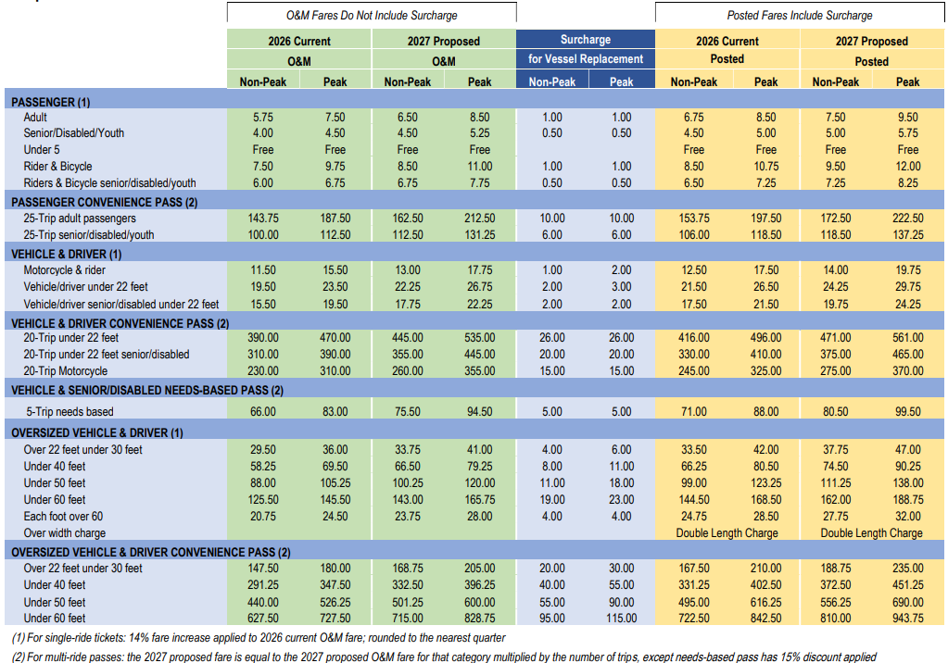
2026 Current & 2027 Proposed Fares

Slide 17
Timeline (subject to change)
Milestone | Target Date
Post 2026 Draft Revenue Target Report & 2027 Proposed Fare Schedule Online | Aug. 4
Early Opportunity for Public Feedback | Aug. 4 - 18
Work Session with Board of Skagit County Commissioners Discuss 2026 Draft Ferry Fare Revenue Target Report | Aug. 6; 9:30 a.m.
Presentation to the Board of Skagit County Commissioners 2026 Ferry Fare Revenue Target Report | Aug. 18; 8:30 a.m.
Community Meeting | Aug. 19; 3-4:30 p.m.
Public Comment Period Prior to Public Hearing | Sept. 3-22
Public Hearing – Public Comment Closes at the Close of the Public Hearing | Sept. 22; 8:30 a.m.
Public Comment Evaluation/Final Resolution Prep | Sept. 23-Oct. 2
Resolution on stand-alone agenda for request for motion for adoption | Oct. 20; 8:30 a.m.
File Application for Certification of Tolls with WSDOT (60 days prior to implementation) | Oct. 29
New Fares (if approved) Take Effect | Jan. 1, 2027

Slide 18
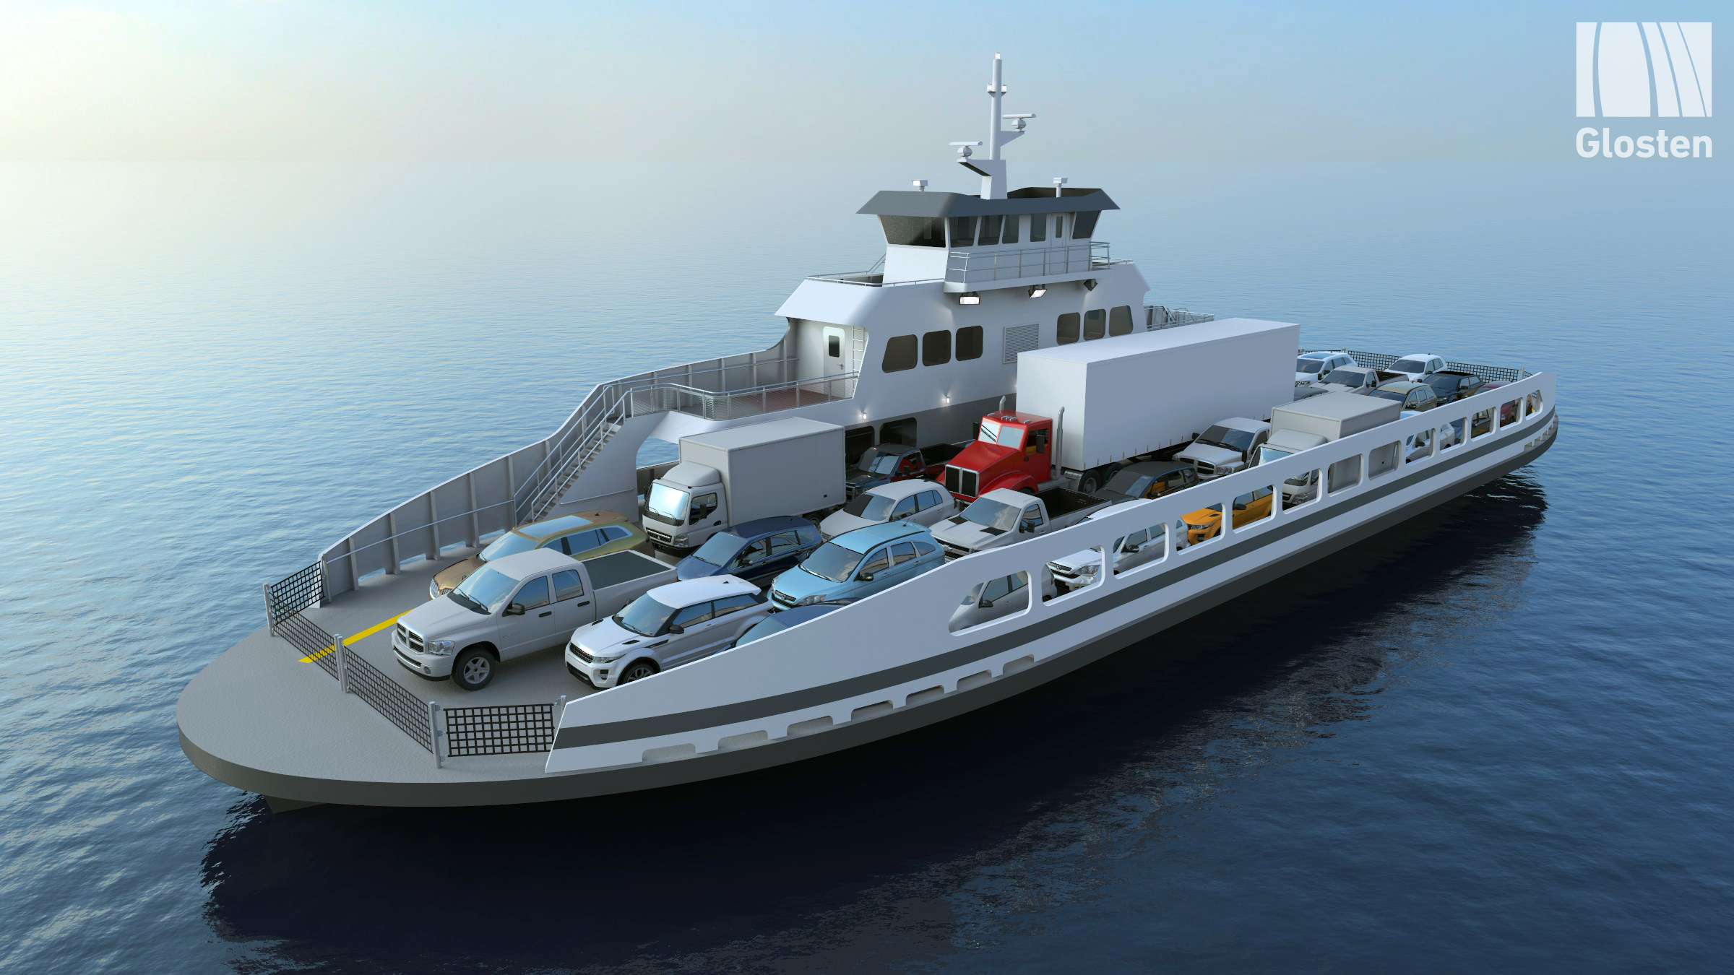
Comments
ferrycomments@co.skagit.wa.us

Slide 19
Ridership 2021 - 2025

Slide 20
Ridership 2018 - 2025

Slide 21
Ridership 2018 - 2025

Slide 22
Revenue 2021 - 2027
Fare Box Revenue 2021-2027
 | 2021 | 2022 | 2023 | 2024 | 2025 | 2026 Proj. | 2027 Proj.
Farebox Revenue | $ 1,115,037 | $ 1,200,489 | $ 1,250,681 | $ 1,346,019 | $ 1,455,098 | $ 1,900,000 | $ 2,529,869
Revenue Target | $ 1,386,935 | $ 1,463,031 | $ 1,307,220 | $ 1,307,220 | $ 1,818,971 | $ 2,319,876 | $ 2,524,174

Slide 23
Ferry Division Expenditures – 2025
Expenditures |  | 2025 Actual | 2025 Budgeted | % Difference
Obj. 510 - Salaries & Wages |  | $ 1,338,537.09 | $ 1,441,153.00 | -7%
Obj. 520 - Personnel Benefits |  | $ 482,100.43 | $ 530,199.00 | -9%
Obj. 530 - Supplies/Consumables |  | $ 282,491.57 | $ 445,850.00 | -37%
 | 3120 - Operating Supplies | $ 101,972.34 | $ 150,000.00 | -32%
 | 3200 - Fuel | $ 159,964.08 | $ 273,850.00 | -42%
 | 3412 - Interfund Parts & Materials | $ 54.23 | $ 2,000.00 | -97%
 | 3510 - Small Tools & Minor Equipment | $ 20,500.92 | $ 20,000.00 | 3%
Obj. 540 - Services & Pass Through Payments |  | $ 2,591,008.81 | $ 3,183,934.00 | -19%
 | 4110 - Professional Services | $ 294,086.66 | $ 310,040.00 | -5%
 | 4218 - Professional Services (Other) | $ 663.70
 | 4153 - Intergovernmental Professional Svcs. | $ - | $ 12,000.00 | -100%
 | 4154 - Interfund Payment for Service | $ 13,978.48
 | 4155 - External Taxes & Ops Assessment | $ 33,144.50 | $ 35,000.00 | -5%
 | 4190 - Interfund Information Services | $ 98,644.52 | $ 85,127.00 | 16%
 | 4230 - Communications | $ 11,501.27 | $ 10,000.00 | 15%
 | 4310 - Travel | $ 4,989.52 | $ 8,018.00 | -38%
 | 4361 - Meals | $ 580.46 | $ 500.00
 | 4410 - Advertising | $ 731.68 | $ 5,000.00 | -85%
 | 4510 - Rentals | $ 463,803.50 | $ 445,300.00 | 4%
 | 4511 - Interfund Equipment Rental | $ 18,472.77 | $ 15,000.00 | 23%
 | 4610 - Insurance | $ 99,341.00 | $ 376,400.00 | -74%
 | 4700 - Utilities | $ 38,754.42 | $ 35,000.00 | 11%
 | 4810 - Repairs & Maintenance | $ 1,433,848.72 | $ 1,776,549.00 | -19%
 | 4811 - Interfund Shop Labor | $ 17,451.50 | $ 5,000.00 | 249%
 | 4910 - Miscellaneous | $ 61,016.11 | $ 65,000.00 | -6%
 | O&M Total | $ 4,694,137.90 | $ 5,601,136.00 | -16%
Obj. 560 - Capital Outlays |  | $ 1,330,090.15 | $ 1,743,083.00 | -24%
 | 6310 - Other Improvements |  | $ 200,000.00 | -100%
 | 6411 - Equipment > $5,000 | $ 1,330,090.15 | $ 1,543,083.00 | -14%
 | Total ⁽¹⁾ | $ 6,024,228.05 | $ 7,144,219.00 | -16%
Source: Skagit County Cayenta Financial System Report Budget Monitoring 117-4 FY25

